Slide 1
TELERIK FIDDLER
a free web debugging proxy for any browser, system or platform

Slide 2
Key Features
Web Session Manipulation - edit web sessions easily, just set a breakpoint to pause the processing of the session and permit alteration of the request/response. Compose your own HTTP requests and run them through Fiddler.
Performance Testing - see the “total page weight,” HTTP caching and compression at a glance. Isolate performance bottlenecks with rules such as “Flag any uncompressed responses larger than 25kb.”
Security Testing - decrypt HTTPS traffic and display and modify web application requests using a man-in-the-middle decryption technique. Configure Fiddler to decrypt all traffic, or only specific sessions.
HTTP/HTTPS Traffic Recording - log all HTTP(S) traffic between your computer and the Internet. Debug traffic from virtually any application that supports a proxy (IE, Chrome, Safari, Firefox, Opera and more).
Web Debugging - debug traffic from PC, Mac or Linux systems and mobile (iOS and Android) devices. Ensure the proper cookies, headers and cache directives are transferred between the client and server. Supports any framework, including .NET, Java, Ruby, etc.
Customizable Free Tool - rich extensibility model, ranging from simple Fiddler Script to powerful extensions which can be developed using any .NET language.

Slide 3
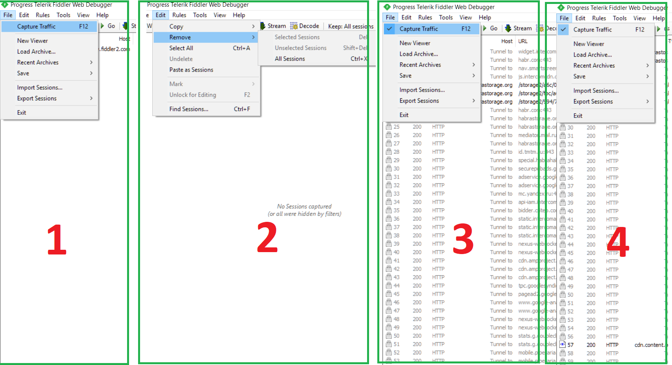
Capturing the HTTP/HTTPS sessions for debugging with Fiddler: Run the Fiddler >> Stop capturing the traffic by pressing “F12” or go to menu “File” and check checkbox “Capture Traffic” (1) >> Clear the captured session by clicking the “Remove - All Sessions” from menu “Edit” or press “CTRL+X” (2) >> Start capturing the traffic by pressing “F12” or go to menu File and check checkbox “Capture Traffic” (3) >> Open the web-site or run the application >> Export or Save session (4)

Slide 4
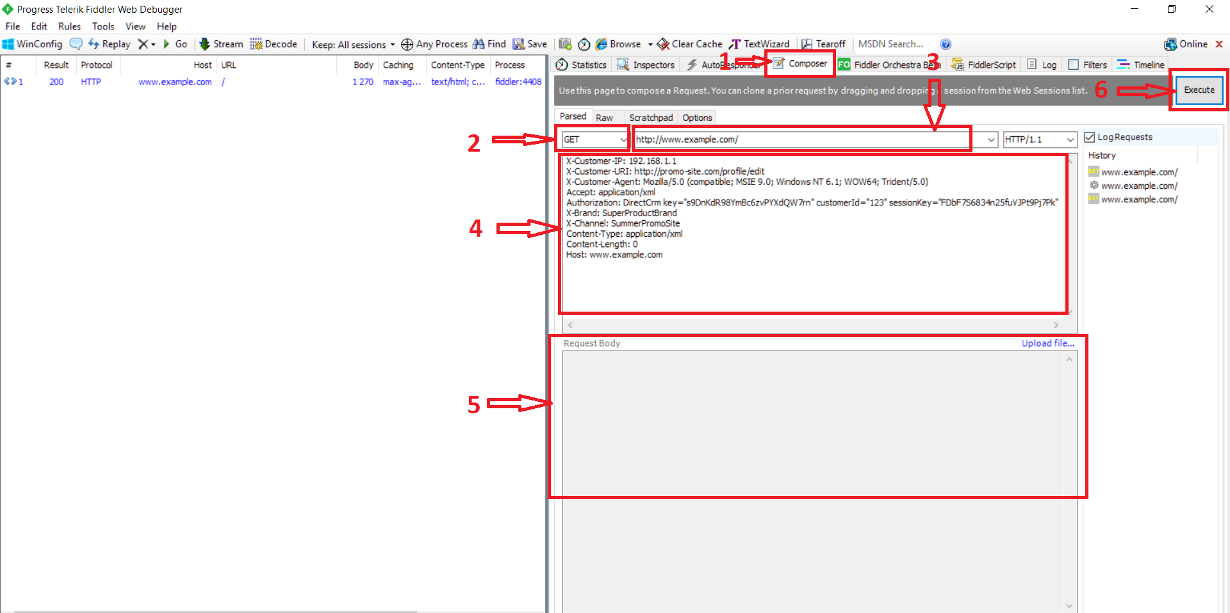
Testing the requests with Fiddler (creating the requests): Run the Fiddler >> Stop capturing the traffic by pressing “F12” or go to menu “File” and check checkbox “Capture Traffic” >> Clear the captured session by clicking the “Remove - All Sessions” from menu “Edit” or press “CTRL+X” >> Go to the tab “Composer” (1) >> Choose the right method (Get, Post) (2) >> Create the URL of request (3) >> Write the necessary headlines (4) >> Determine the body of request if needed (5) >> Click the button “Execute” (6)

Slide 5
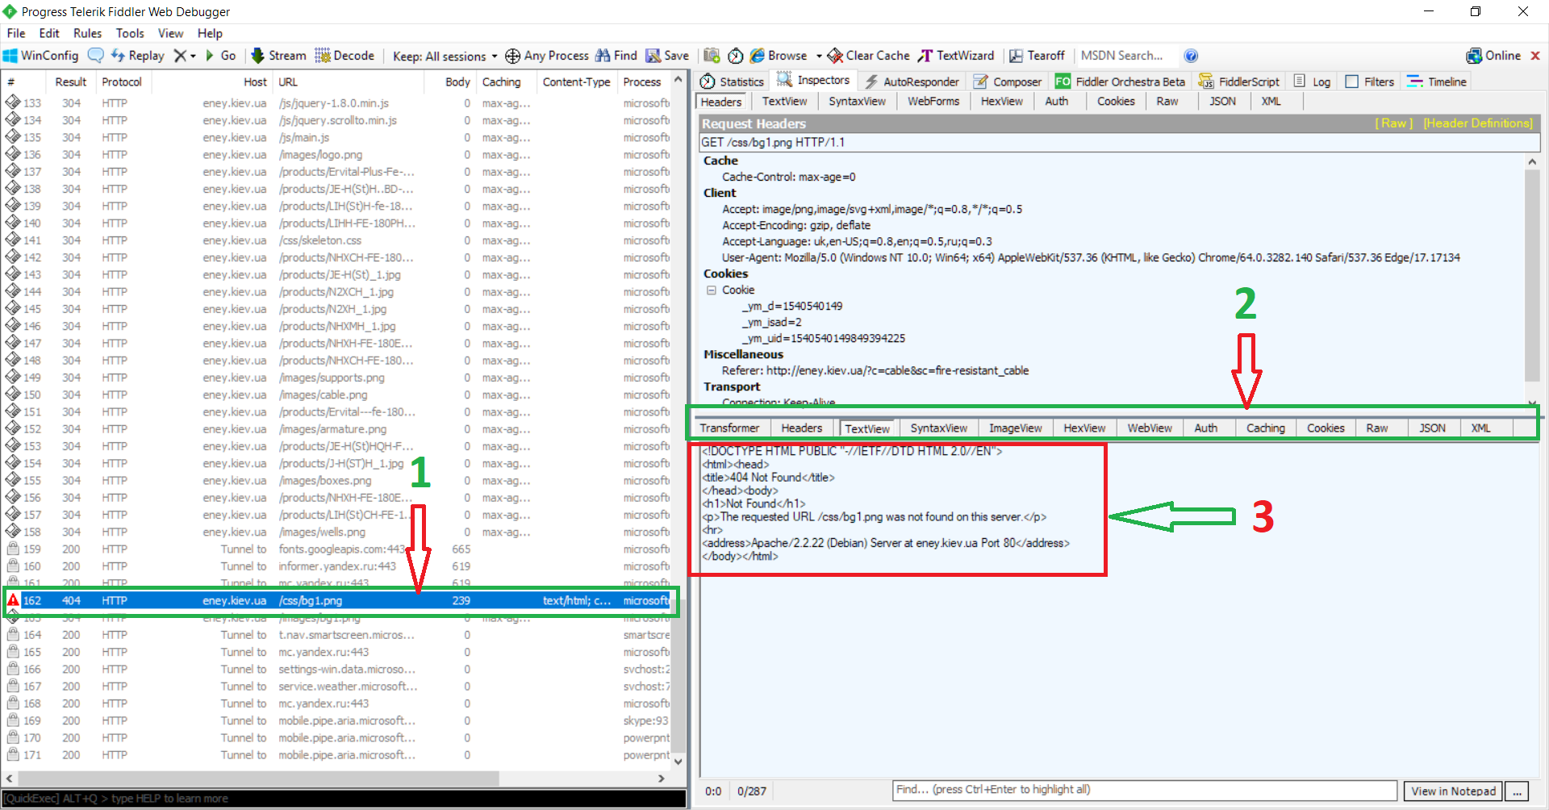
Testing the requests with Fiddler (reading the response on request): Create and execute the request as on previous page >> Double click the request on the left side of the program window to open it (1) >> Check the response on request on the right side of the window >> Choose the type of view (2) >> Check the server response (answer) (3) Status Code Definitions (Column “Result” of left side of Fiddler’s window) - https://www.w3.org/Protocols/rfc2616/rfc2616-sec10.html

Slide 6
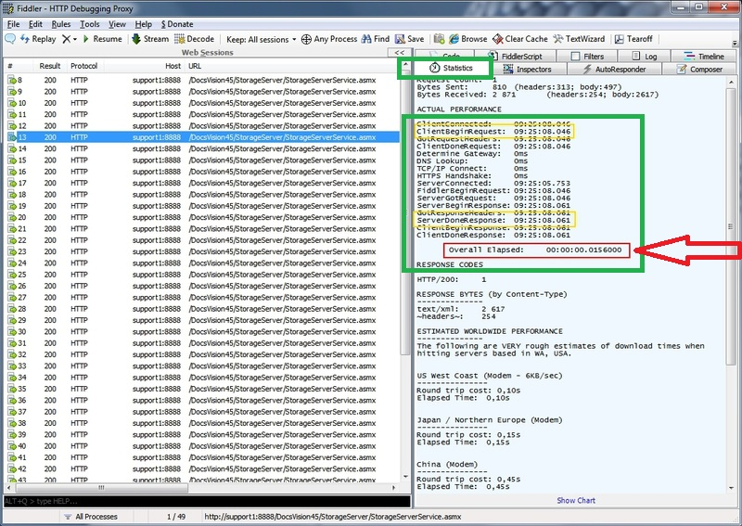
Testing performance with Fiddler (checking the time of request execution): Menu “Rules” >> Tab “Performance” >> Chose a condition if needed >> Tab “Statistics” of the right side of window

Slide 7
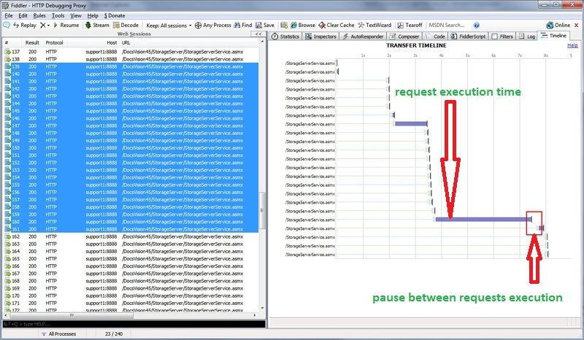
Testing performance with Fiddler (checking for the pauses between requests execution): Select several requests on the left side of window >> Click the tab “Timeline” of the right side of window

Slide 8
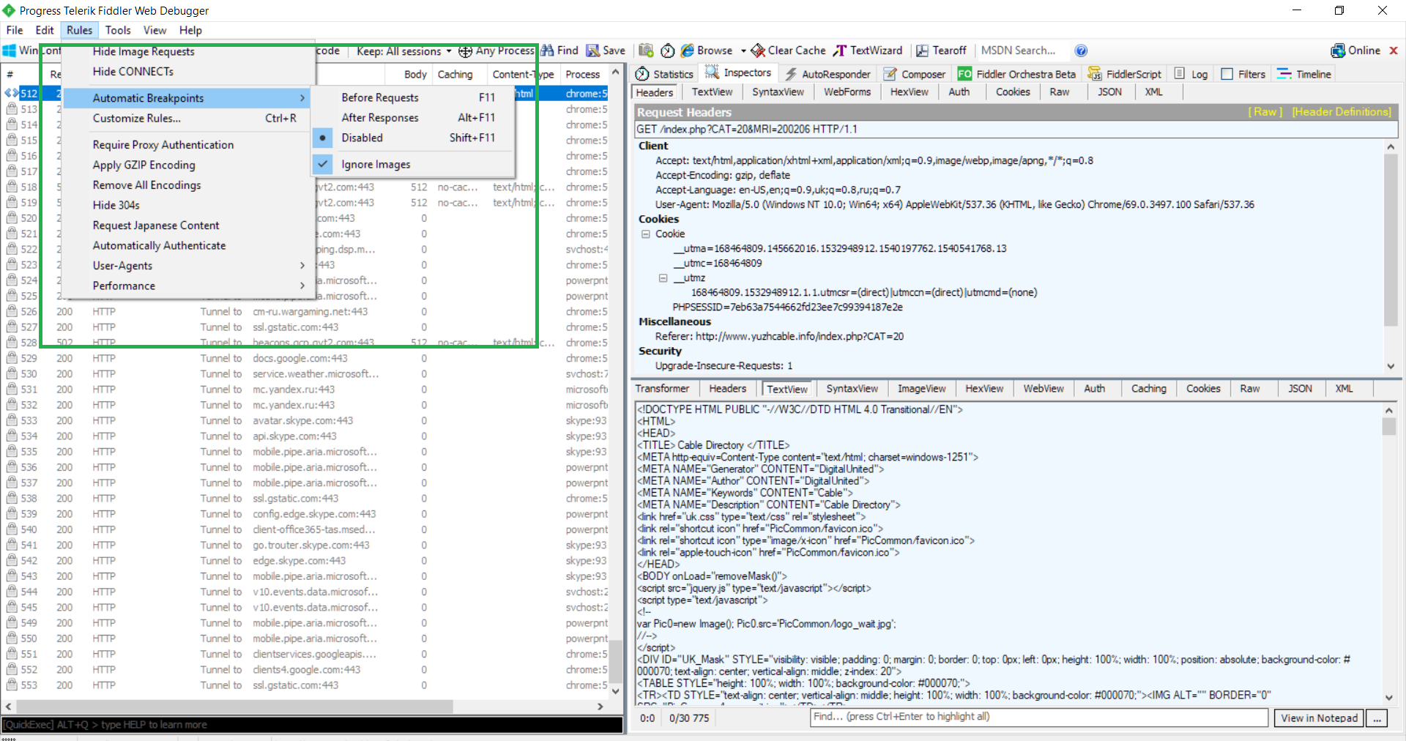
Setting the breakpoints with Fiddler: Tamper a session by setting breakpoints that can be automatic (after/before every request or response) or custom ones – insert breakpoints only when certain conditions are met. You can also use the quick exec box to create simple breakpoints for whenever a certain URL is hit. Fiddler then pauses the processing of the session and permits manual alteration of the request and the response. You can also choose the response that will be automatically returned.

